Slide 1



Exploratory Data Analysis Project on NETFLIX movies and TV shows dataset

Slide 2


Objective
Our goal in this project is to explore Netflix’s entire content library — all the movies and TV shows — and uncover interesting patterns and trends. The dataset includes details like the title, director, cast, genre, country of origin, release year, duration, and rating.
Using Exploratory Data Analysis, or EDA, we try to understand the story behind the data. EDA is basically the process of cleaning the data, organizing it, and then visualizing it so that we can clearly see what’s going on. It helps us answer questions like:
Which countries produce the most Netflix content?
What genres are most popular?
Are movies more common than TV shows?
How has Netflix content grown over the years?
What ratings are most frequently assigned?
So the whole purpose of this project is not just to look at the numbers, but to interpret them and find meaningful insights about Netflix — its content distribution, its global reach, and the preferences of its audience.

Slide 3






Methodology
1. Data Cleaning
Identified and handled missing values
Removed
duplicate records
Corrected inconsistent
or incomplete data
2. Feature Exploration
Examined key attributes:
Type, Rating, Country
, Genre
Understood distribution
and structure of each
feature
3.Data Visualization
Created visual charts for analysis:
Bar plots, Count plots, Line charts, etc.
Used plots to observe trends and compare categories
4. Insight Extraction
Summarized major findings from EDA
Interpreted patterns in Netflix content distribution and trends

Slide 4



Importing Libraries & Loading the Dataset
Before starting the analysis, I set up all the important Python libraries needed for this project.
I imported Pandas to handle and clean the data.
NumPy is used for numerical operations.
Matplotlib and Seaborn are my visualization libraries, which help me create clear and meaningful graphs.
I also imported os for interacting with the file system if needed.
Then, I used %matplotlib inline so that all the plots show directly inside the Jupyter Notebook.
Finally, I set the Seaborn style to whitegrid to make the charts cleaner and easier to read.

Slide 5

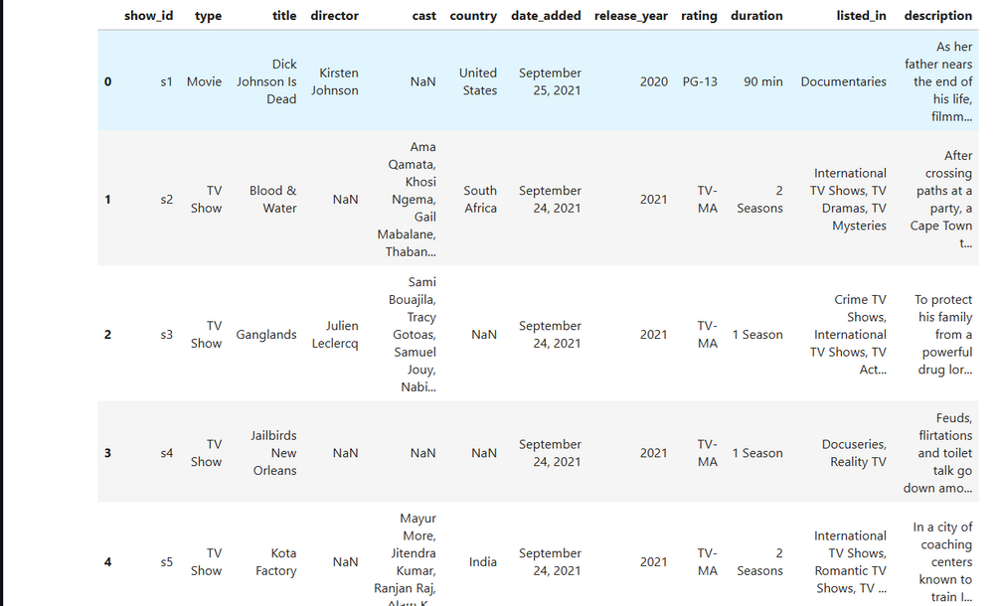
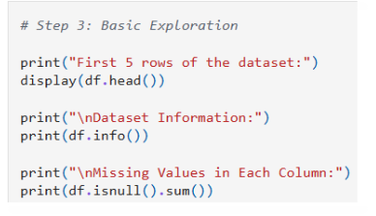
First Look at the Data
After loading the dataset, the first thing I did was simply ‘get to know it.’
I checked how many rows and columns we have, what each column represents, and whether we have missing or incomplete information.
Here, I noticed something important:
columns like Director, Cast, and Country had quite a lot of missing values.
This is actually very common in entertainment data because not every title has complete metadata available.
But understanding these gaps early helps us decide how to clean and prepare the data for deeper analysis.

Slide 6


Data Cleaning
After understanding the dataset, I cleaned it to make it ready for analysis — kind of like preparing ingredients before cooking a dish.
Here’s what I did:
• Removed duplicate rows
• Filled missing values with ‘Not Available’
• Converted the ‘date_added’ column into proper datetime
• Separated the ‘duration’ column into numeric value and duration type

Slide 7

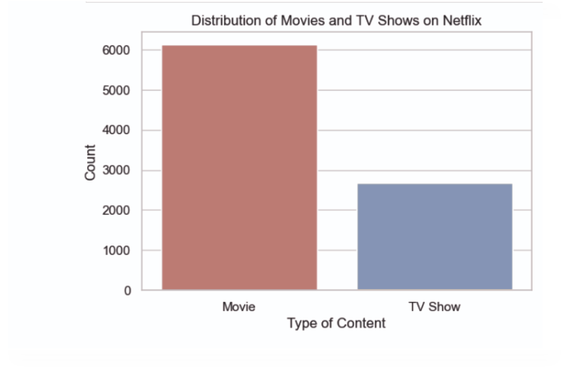
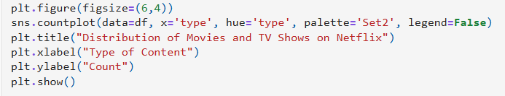
Movies vs TV Shows
To get an idea of what Netflix has more of — movies or TV shows — I created a simple count plot.
As the graph shows, Netflix has far more Movies than TV Shows.
This tells us that although Netflix is known for its series, its library is actually dominated by films.
sns.countplot counts how many records belong to each category.

Slide 8

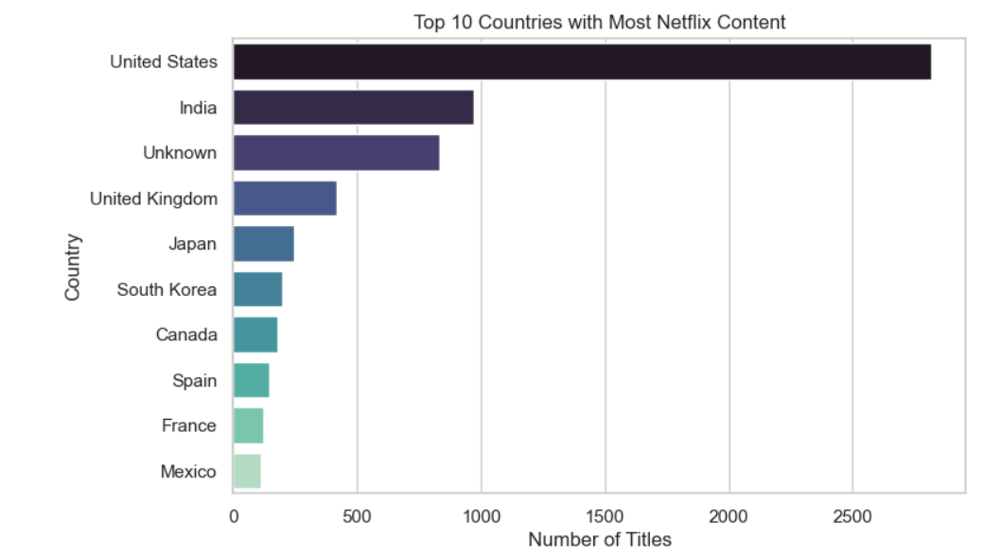
Top 10 Countries Producing Netflix Content
Next, I looked at which countries produce the most content on Netflix.Because some entries list multiple countries (for example ‘USA, Canada’), I first split those multi-country entries so each country gets counted fairly. After that, I counted titles per country and displayed the top ten. This lets us see Netflix’s strongest production markets — and it reveals how global the library truly is.
Code Explanation:
df['country'].value_counts():Counts how many times each country appears in the dataset.
.head(10):Selects the top 10 most frequent countries.
sns.barplot(...):Creates a clean horizontal bar chart for better readability.
palette='mako':Adds a smooth, professional color theme to the bars.
legend=False:Removes unnecessary legends since the country labels are already shown.

Slide 9

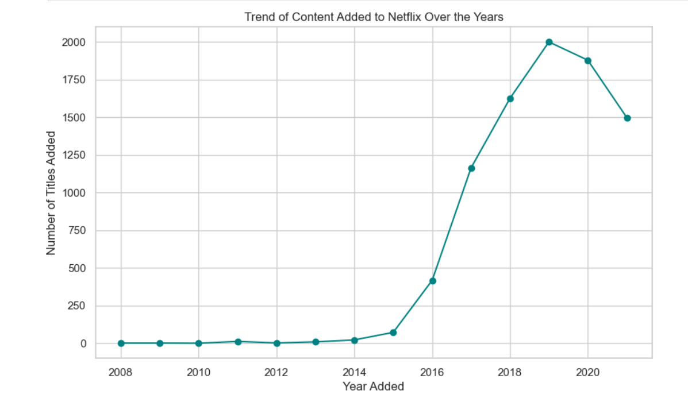
Trend of Content Added Over the Years
This graph shows how many titles were added to Netflix each year.When we look at the trend, we can clearly see a huge rise after around 2015.This was the period when Netflix expanded globally and started investing heavily in original content. The sharp increase continues till around 2019–2020, showing Netflix’s peak growth phase.This trend tells us that Netflix didn’t just grow steadily — it grew explosively, especially during its global expansion years.
I used value_counts() to count how many titles were added each year, then sorted them in order and plotted them using a line graph.
Breakdown of our code
df['year_added'].value_counts()→Counts number of titles added each year
.sort_index() → Sorts the years in chronological order
.plot(kind='line', marker='o', color='teal')→ Creates a clean line graph with circular data points
plt.grid(True) → Makes the trend easier to read

Slide 10

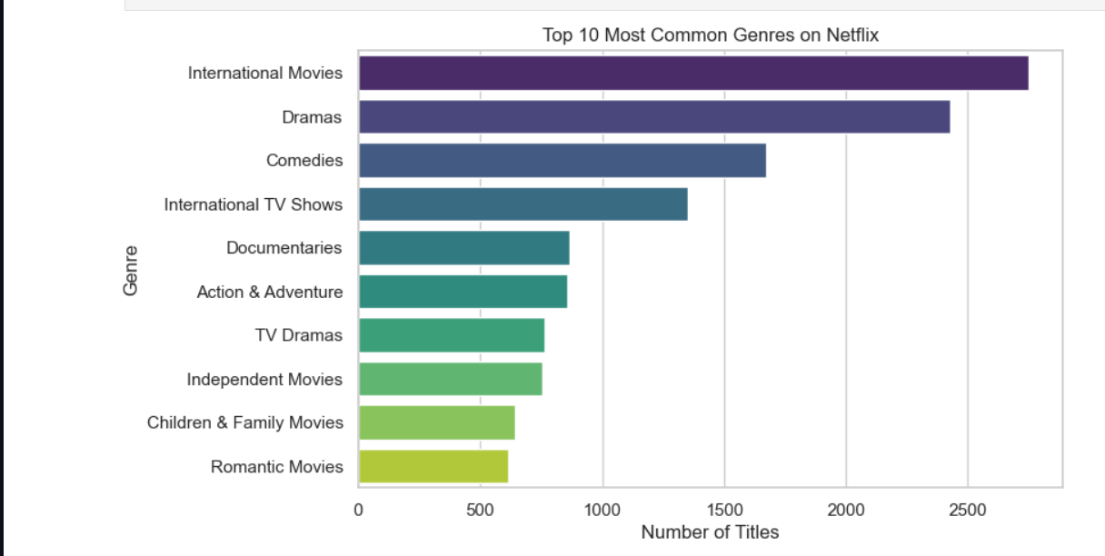
Top 10 Most Common Genres on Netflix
In this slide, I wanted to understand what kind of content Netflix focuses on the most.To do that, I analyzed the ‘listed_in’ column, which contains the genres for each title.Since many titles have multiple genres, I split them, extracted all genres separately, and counted how often each one appeared.The bar chart shows the top 10 most common genres on Netflix.
This graph clearly shows that Netflix’s strongest categories are:
Dramas
International Movies
Documentaries
Comedies
This tells us that Netflix invests heavily in story-driven content, global cinema, and real-life documentary-style content.
It also shows that Netflix’s library is very diverse and appeals to a wide audience

Slide 11

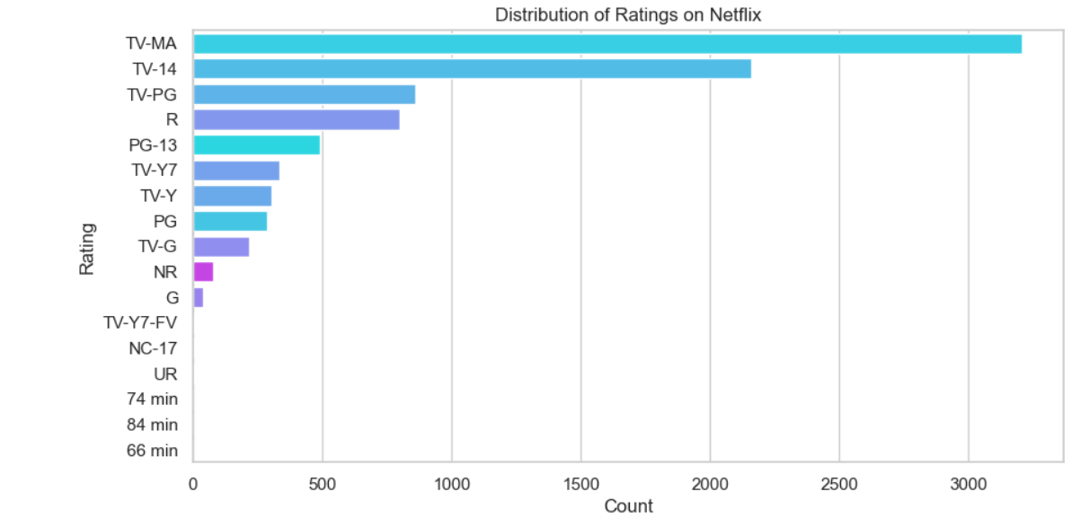
Distribution of Ratings on Netflix
Next, I analyzed the ratings of Netflix titles to understand which age groups Netflix focuses on the most.Ratings tell us whether a show or movie is made for kids, teens, or adults.When we look at this bar chart, we can see that the most common rating on Netflix is TV-MA, which is for mature audiences.That means a large portion of Netflix content is made for adults.Other ratings like TV-14 and TV-PG also appear often, but the majority clearly leans toward adult viewers.
This distribution shows that Netflix mainly targets adults rather than kids or family audiences, which matches its trend of producing bold, intense, and mature content.
To plot the rating distribution, I used a countplot.
A countplot automatically counts how many titles fall into each rating category.

Slide 12

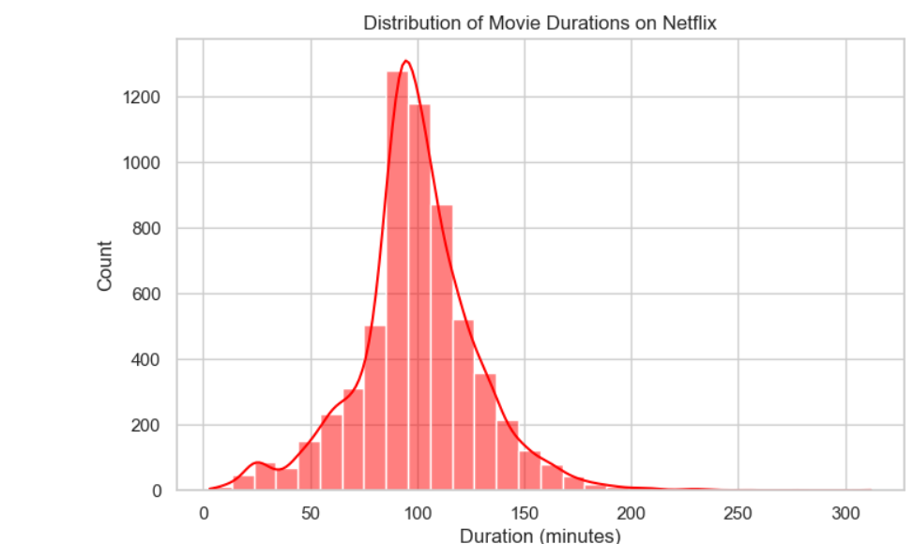
Distribution of Movie Durations on Netflix
In this analysis, I focused only on Netflix movies to understand how long their films usually are.After cleaning the duration column, I plotted a distribution chart to see the most common movie lengths.
Netflix’s movie library mostly sticks to typical feature film durations — this matches audience preferences for movies that are 1.5 to 2 hours long.
To analyze movie durations, I first filtered out only the movies and then converted the duration column from text into numerical values.
This analysis shows that Netflix movies usually follow classic movie lengths, with most titles falling in the 90–120 minute range.
This tells us that Netflix prefers traditional movie runtimes rather than very short or very long formats.

Slide 13

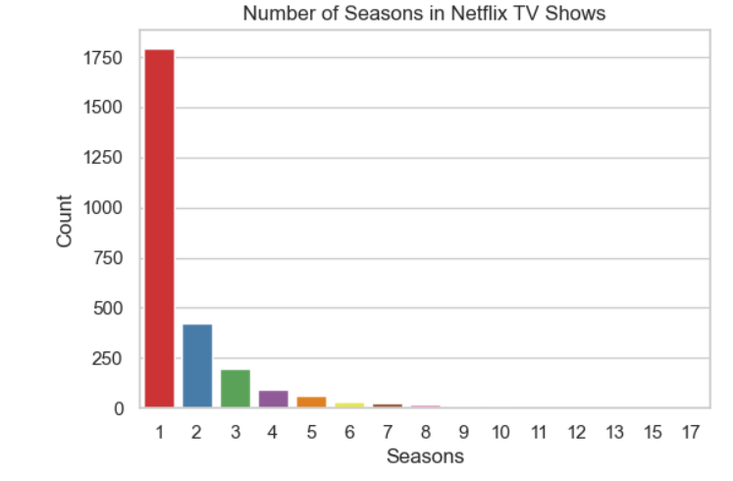
TV Show Seasons Distribution
In this step, I focused only on Netflix TV Shows to understand how many seasons they usually have.Most Netflix series are known for shorter season counts, so this analysis helps confirm that pattern.To begin, I filtered out only the TV Show entries and then cleaned the ‘duration’ column, because for TV shows, the duration doesn't represent minutes — it represents the number of seasons.
After cleaning it, I plotted a count plot to see how many seasons most Netflix series have.
The bar chart on screen shows the distribution — the number of TV shows with 1 season, 2 seasons, 3 seasons, and so on.
You’ll notice the majority of shows are 1 or 2 seasons long — this tells us Netflix favors shorter, limited-series formats that are easy for viewers to binge-watch. I also printed the percentages (on my notebook) — about X% of TV shows have 1 season and about Y% have 2 seasons, which further emphasizes the limited-series trend.

Slide 14

Conclusion
To conclude this project, our Exploratory Data Analysis helped us uncover how Netflix structures and expands its content library.
By cleaning, analyzing, and visualizing the dataset, we were able to clearly understand patterns in production countries, content types, genres, ratings, and release trends.
Key Takeaways
Movies dominate Netflix’s content library, but TV Shows grew rapidly after 2016 due to Netflix Originals.
Netflix’s biggest contributors are the United States and India, reflecting a global content strategy.
The most common ratings are TV-MA and TV-14, showing a strong focus on mature and teen audiences.
Popular genres include International Movies, Dramas, Comedies, and Documentaries.
Most TV shows have 1–2 seasons, highlighting Netflix’s trend toward limited-series formats.
Content production significantly increased between 2015–2020, aligning with Netflix’s worldwide expansion.
Closing Thought
“This analysis shows that Netflix is not just a streaming platform — it is a data-driven content creator.
Through EDA, we were able to turn raw data into clear insights that reveal how Netflix builds its global entertainment ecosystem.”

